Slide 1

Memory
Chris Piech
CS106A, Stanford University

Slide 2

Learning Goals
Be able to trace memory with references

Slide 3
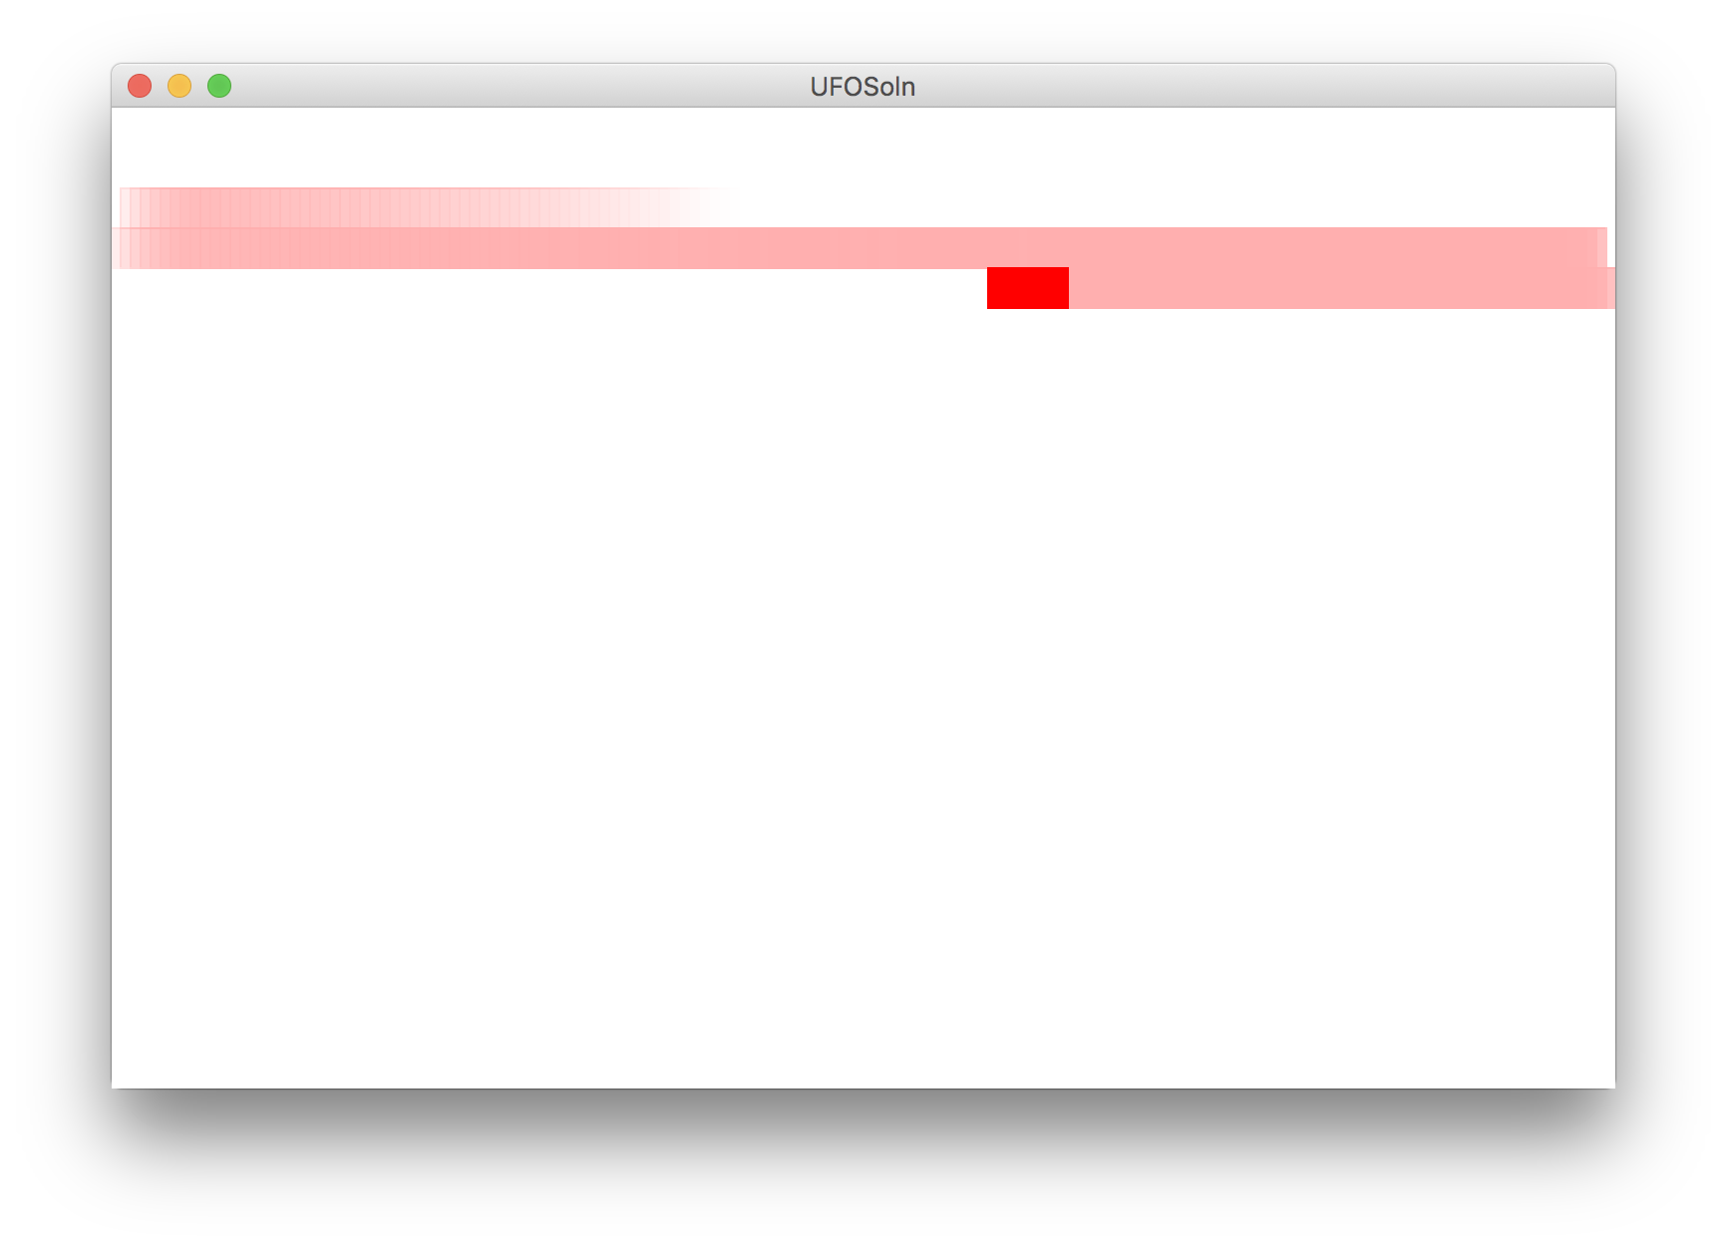
Write this program

Slide 4
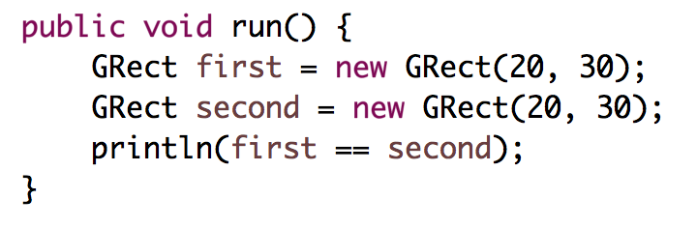
Who thinks this prints true?

Slide 5
Who thinks this prints true?
public void run() {
int x = 5;
int y = 5;
println(x == y);
}
Notes:
true

Slide 6
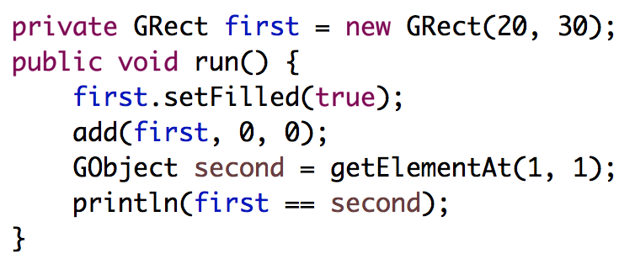
Who thinks this prints true?

Slide 7
Class of the 10 keys

Slide 8
Advanced memory model

Slide 9
Core memory model

Slide 10
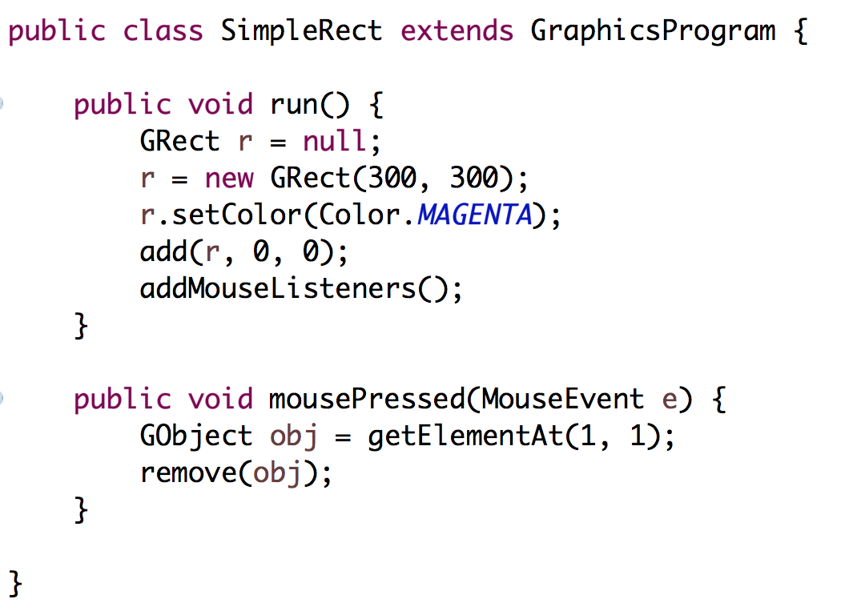
Stack Diagrams
public void run() {
println(toInches(5));
}
private int toInches(int feet){
int result = feet * 12;
return result;
}
run

Slide 11
Stack Diagrams
public void run() {
println(toInches(5));
}
private int toInches(int feet){
int result = feet * 12;
return result;
}
run

Slide 12
Stack Diagrams
public void run() {
println(toInches(5));
}
private int toInches(int feet){
int result = feet * 12;
return result;
}
f
run
toInches
feet
5

Slide 13
Stack Diagrams
public void run() {
println(toInches(5));
}
private int toInches(int feet){
int result = feet * 12;
return result;
}
f
run
toInches
feet
5
result
60

Slide 14
Stack Diagrams
public void run() {
println(toInches(5));
}
private int toInches(int feet){
int result = feet * 12;
return result;
}
f
run
toInches
feet
5
stack
result
60

Slide 15
Stack Diagrams
public void run() {
println(toInches(5));
}
private int toInches(int feet){
int result = feet * 12;
return result;
}
f
run
60

Slide 16
Aside: Actual Memory

Slide 17
What is a bucket
feet
5

Slide 18
What is a bucket
feet
1011100111100011
0011010110010100
* Each bucket or “word” holds 64 bits
** don’t think on the binary level (yet)

Slide 19
#0: variables have fixed size buckets to store values

Slide 20
End aside

Slide 21
Primitives vs Classes
Primitive Variable Types
Class Variable Types
int
double
char
boolean
GRect
GOval
Gline
Color
Class variables (aka objects)
Have upper camel case types
You can call methods on them
Are constructed using new
Are stored in a special way

Slide 22
Primitives vs Classes
Primitive Variable Types
Class Variable Types
int
double
char
boolean
GRect
GOval
Gline
Color
aka
Objects
Class variables (aka objects)
Have upper camel case types
You can call methods on them
Are constructed using new
Are stored in a special way

Slide 23
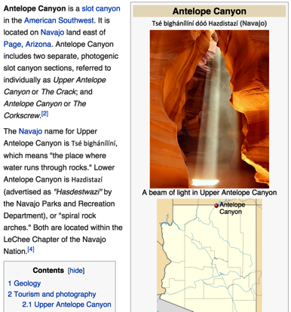
How do you share wikipedia articles?
Antelope Canyon Article
Key:
https://en.wikipedia.org/wiki/Antelope_Canyon

Slide 24
All of todays class:
Objects store addresses
(which are like URLs)

Slide 25
What does an object store?

Slide 26
Objects store addresses
(which are like URLs)

Slide 27

By Chris Piech

Slide 28
origin
Nick Troccoli
By Chris Piech

Slide 29
Once upon a time…

Slide 30
…a variable x was born!
int x;

Slide 31
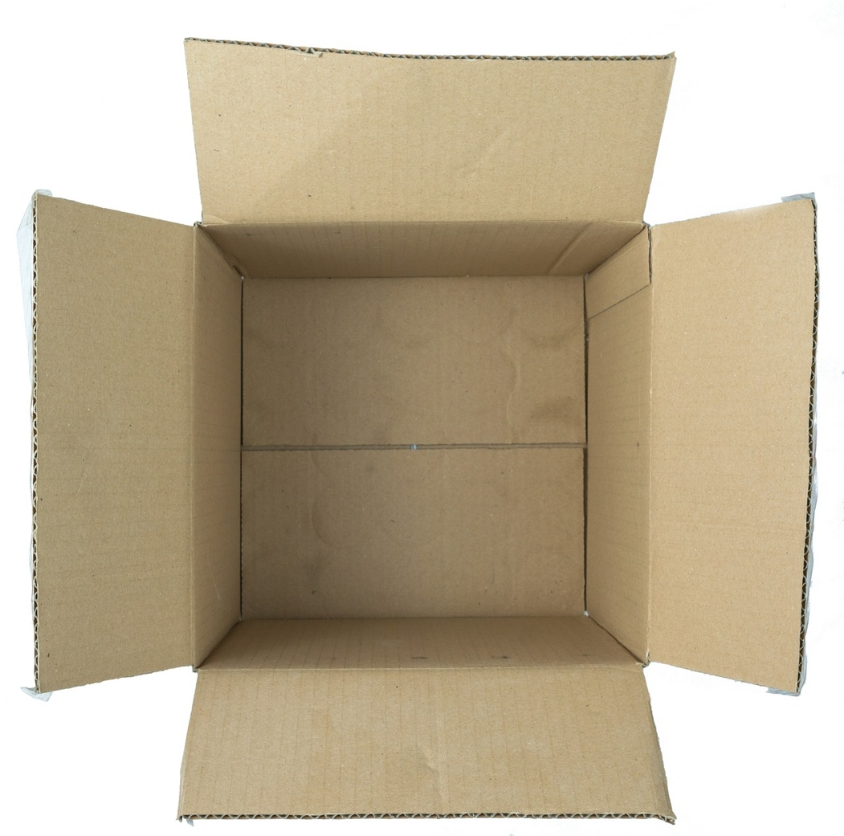
…a variable x was born!
int x;

Slide 32
x was a primitive variable…
int x;
It’s so cuuuute!
Aww…!

Slide 33
…and its parents loved it very much.
int x;
We should give it…. value 27!

Slide 34
…and its parents loved it very much.
x = 27;
We should give it…. value 27!
27

Slide 35
A few years later, the parents decided to have another variable.

Slide 36
…and a variable rect was born!
GRect rect;

Slide 37
rect was an object variable…
GRect rect;
Who’s a cute GRect???
It’s so square!

Slide 38
…and its parents loved it very much.
GRect rect;
We should make it…. a big, strong GRect!

Slide 39
…and its parents loved it very much.
GRect rect = new GRect(0, 0, 50, 50);
We should make it…. a big, strong GRect!

Slide 40
…but rect’s box was not big enough for an object!
GRect rect = new GRect(0, 0, 50, 50);
That box isn’t big enough to store everything about a GRect!

Slide 41


…so they stored the information in a bigger box somewhere else.
GRect rect = new GRect(0, 0, 50, 50);
x = 0, y = 0
width = 50
height = 50
...
Location 5
See location 5
Notes:
Stack and heap

Slide 42
In practice

Slide 43
public void run() {
GRect r = null;
}
Method memory
Object memory

Slide 44
public void run() {
GRect r = null;
}
Method memory
Object memory
run
r
null

Slide 45
Wahoo!

Slide 46
public void run() {
GRect r = new GRect(50, 50);
}
Method memory
Object memory
run
r

Slide 47
public void run() {
GRect r = new GRect(50, 50);
}
Method memory
Object memory
run
memory.com/18
r

Slide 48
public void run() {
GRect r = new GRect(50, 50);
}
Method memory
Object memory
run
memory.com/18
r
memory.com/18

Slide 49
public void run() {
GRect r = new GRect(50, 50);
}
Method memory
Object memory
run
18
r
18

Slide 50
public void run() {
GRect r = new GRect(50, 50);
}
Method memory
Object memory
run
r

Slide 51
public void run() {
GRect r = new GRect(50, 50);
r.setColor(Color.BLUE);
r.setFilled(true);
}
Method memory
Object memory
run
r

Slide 52
public void run() {
GRect r = new GRect(50, 50);
r.setColor(Color.BLUE);
r.setFilled(true);
}
Method memory
Object memory
run
r

Slide 53
public void run() {
GRect r = new GRect(50, 50);
r.setColor(Color.BLUE);
r.setFilled(true);
}
Method memory
Object memory
run
r

Slide 54
#1: new allocates memory for objects
* The data for an object can’t always fit inside a fixed size bucket

Slide 55
#2: object variables store addresses
#ultimatekey

Slide 56
public void run() {
GImage img = new GImage(”mountain.jpg”);
add(img, 0, 0);
}
stack
heap
run

Slide 57
public void run() {
GImage img = new GImage(”mountain.jpg”);
add(img, 0, 0);
}
stack
heap
run

Slide 58
public void run() {
GImage img = new GImage(”mountain.jpg”);
add(img, 0, 0);
}
stack
heap
run

Slide 59
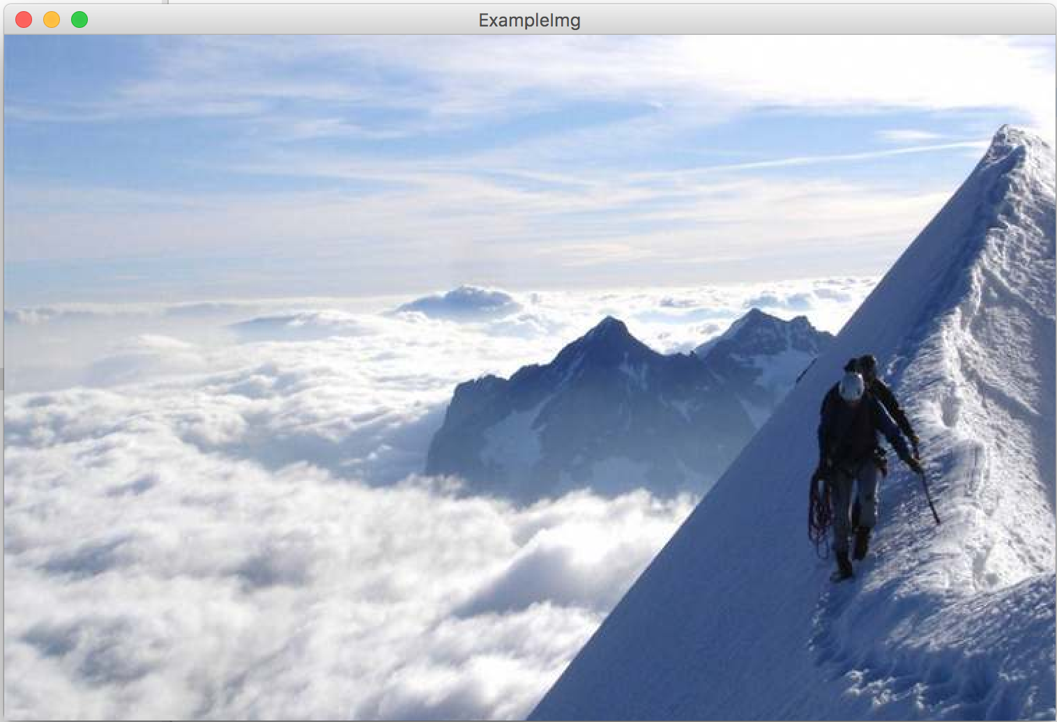
public void run() {
GImage img = new GImage(”mountain.jpg”);
add(img, 0, 0);
}
stack
heap
run

Slide 60
public void run() {
GImage img = new GImage(”mountain.jpg”);
add(img, 0, 0);
}
stack
heap
42
run

Slide 61
public void run() {
GImage img = new GImage(”mountain.jpg”);
add(img, 0, 0);
}
stack
heap
42
run
img

Slide 62
public void run() {
GImage img = new GImage(”mountain.jpg”);
add(img, 0, 0);
}
stack
heap
42
run
img
42

Slide 63
public void run() {
GImage img = new GImage(”mountain.jpg”);
add(img, 0, 0);
}
stack
heap
run
img

Slide 64
public void run() {
GImage img = new GImage(”mountain.jpg”);
add(img, 0, 0);
}
stack
heap
run
img

Slide 66
#3: GImages look impressive but don’t take much extra work

Slide 67
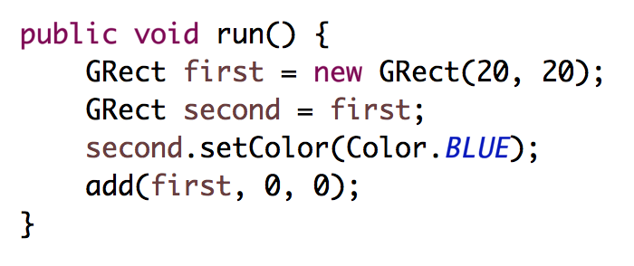
stack
heap
run
first
second

Slide 68
stack
heap
run
32
first
second

Slide 69
stack
heap
run
32
first
32
second

Slide 70
stack
heap
run
32
first
32
second

Slide 71
stack
heap
run
32
first
32
second
32

Slide 72
stack
heap
run
32
first
32
second
32

Slide 73
stack
heap
run
32
first
32
second
32

Slide 74
stack
heap
run
32
first
32
second
32

Slide 75
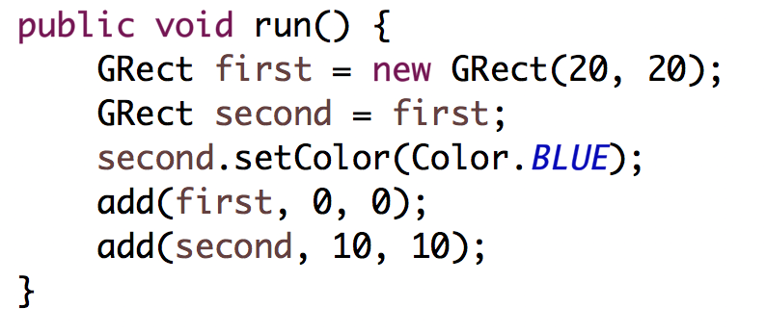
stack
heap
run
32
first
32
second
32

Slide 76
stack
heap
run
32
first
32
second
32

Slide 77
#4: when you use the = operator with objects, it copies the address

Slide 78
What does an object store?

Slide 79
Objects store addresses
(which are like URLs)

Slide 80
Passing by “Reference”

Slide 81
Primitives pass by value
// NOTE: This program is buggy!!
public void run() {
int x = 3;
addFive(x);
println("x = " + x);
}
private void addFive(int x) {
x += 5;
}
* This is probably the single more important example to understand in CS106A

Slide 82
Objects pass by reference
// NOTE: This program is awesome!!
public void run() {
GRect paddle = new GRect(50, 50);
makeBlue(paddle);
add(paddle, 0, 0);
}
private void makeBlue(GRect object) {
object.setColor(Color.BLUE);
object.setFilled(true);
}
* This is probably the single more important example to understand in CS106A

Slide 83
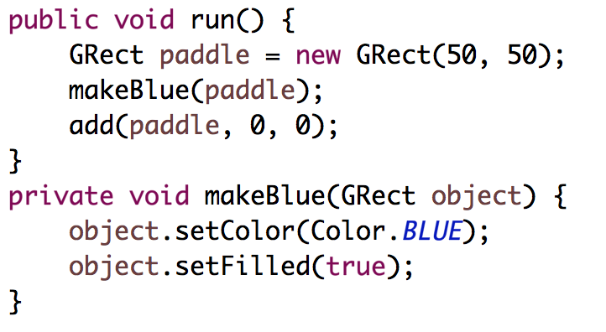

Slide 84
stack
heap
run
paddle

Slide 85
stack
heap
run
18
paddle
18

Slide 86
stack
heap
run
18
paddle
18
makeBlue

Slide 87
stack
heap
run
18
paddle
18
makeBlue
object

Slide 88
stack
heap
run
18
paddle
18
makeBlue
object
18

Slide 89
stack
heap
run
18
paddle
18
makeBlue
object
18

Slide 90
stack
heap
run
18
paddle
18
makeBlue
object
18

Slide 91
stack
heap
run
18
paddle
18
makeBlue
object
18

Slide 92
stack
heap
run
18
paddle
18
makeBlue
object
18

Slide 93
stack
heap
run
18
paddle
18
makeBlue
object
18

Slide 94
stack
heap
run
18
paddle
18
makeBlue
object
18

Slide 95
stack
heap
run
18
paddle
18

Slide 96
stack
heap
run
18
paddle
18

Slide 97
#5: when you pass (or return) an Object, the address is passed.
Aka reference

Slide 98
What does an object store?

Slide 99
Objects store addresses
(which are like URLs)

Slide 100
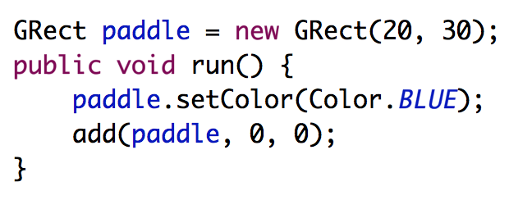
heap
Instance Variables

Slide 101
heap
Instance Variables
18
paddle
18

Slide 102
heap
Instance Variables
18
paddle
18
run

Slide 103
heap
Instance Variables
18
paddle
18
run

Slide 104
#7: there is space for all instance variables. They are accessible by the entire class

Slide 105
#8: instance variables are initialized before run is called

Slide 106
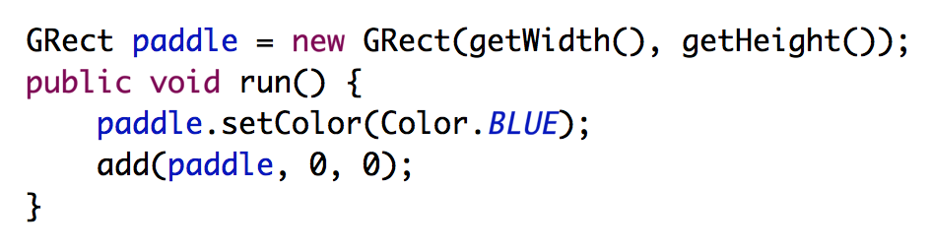
Common Bug
Question: what does this program do?
Answer: makes a square that is 0 by 0 since getWidth is called before the screen has been made.

Slide 107
#9: for objects == checks if the variables store the same address

Slide 108
Recall the start of class?

Slide 109
Who thinks this prints true?

Slide 110
Who thinks this prints true?
public void run() {
int x = 5;
int y = 5;
println(x == y);
}
Notes:
true

Slide 111
Who thinks this prints true?

Slide 112
What does an object store?

Slide 113
Objects store addresses
(which are like URLs)

Slide 114
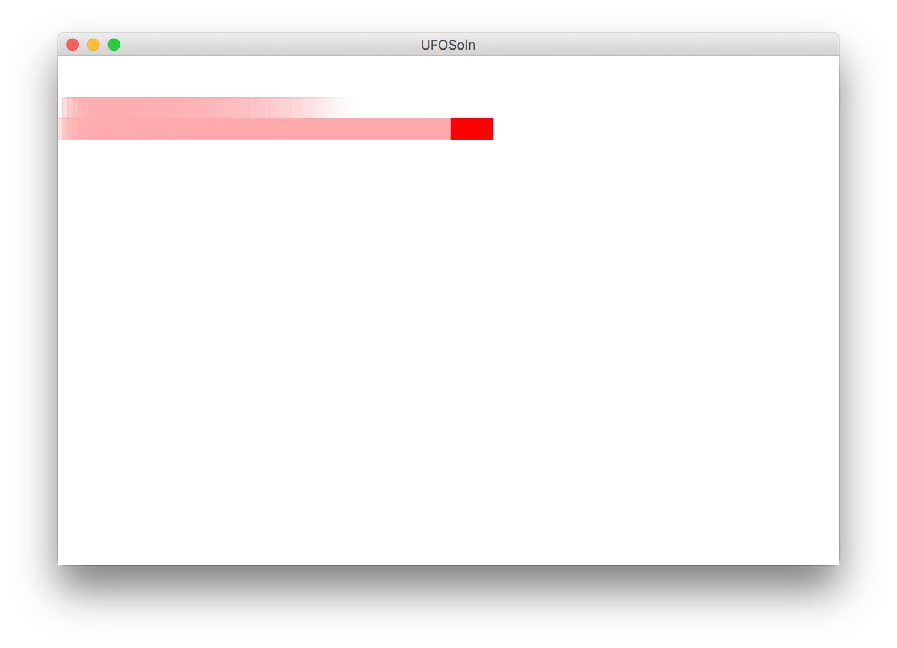
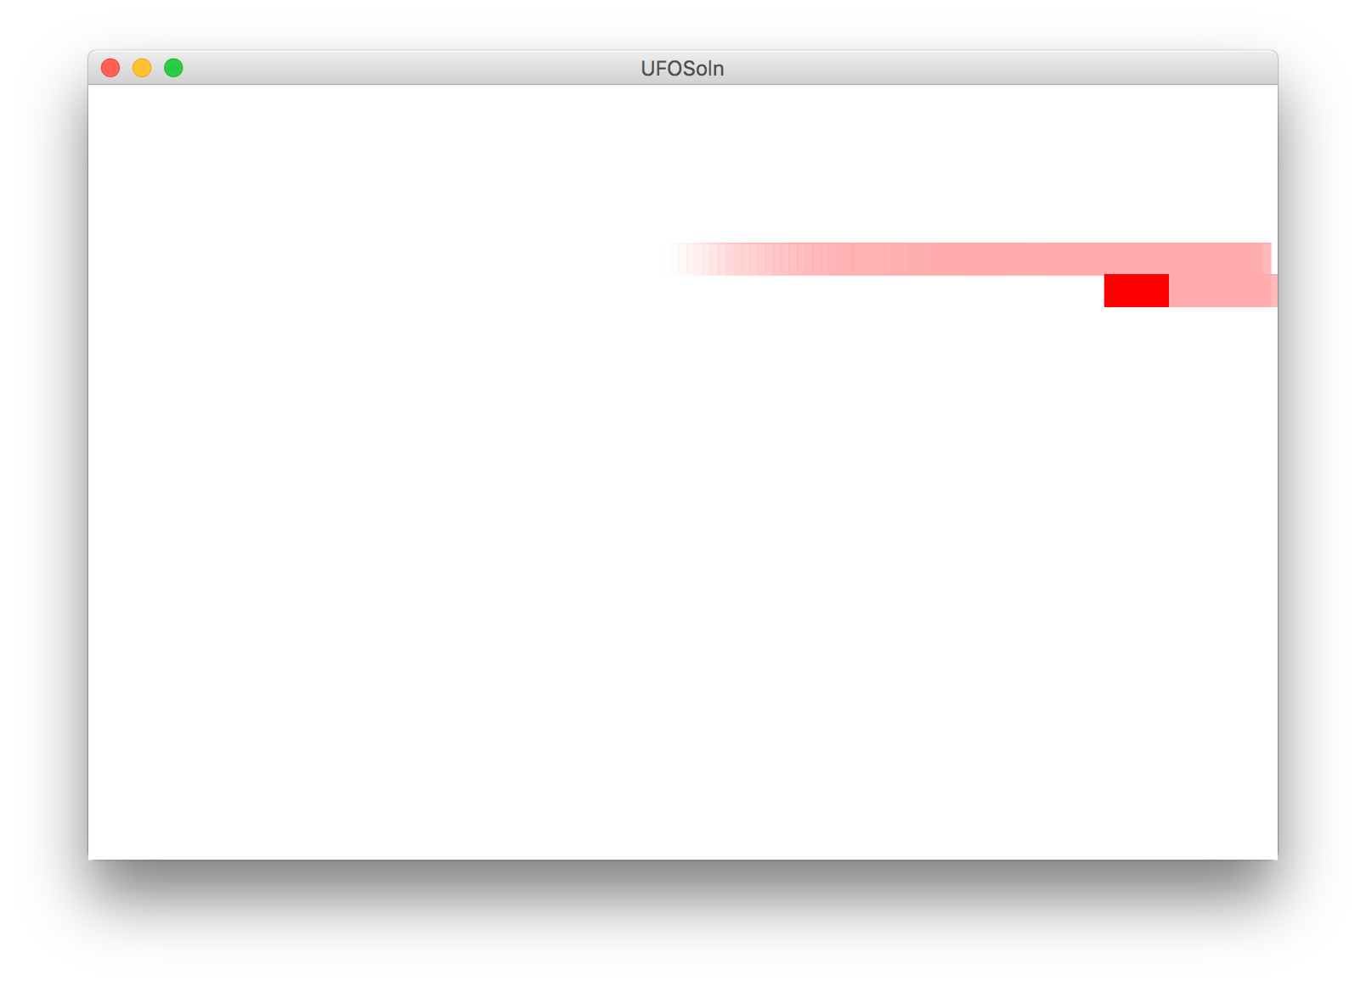
Milestones
Milestone 1
Milestone 2

Slide 115
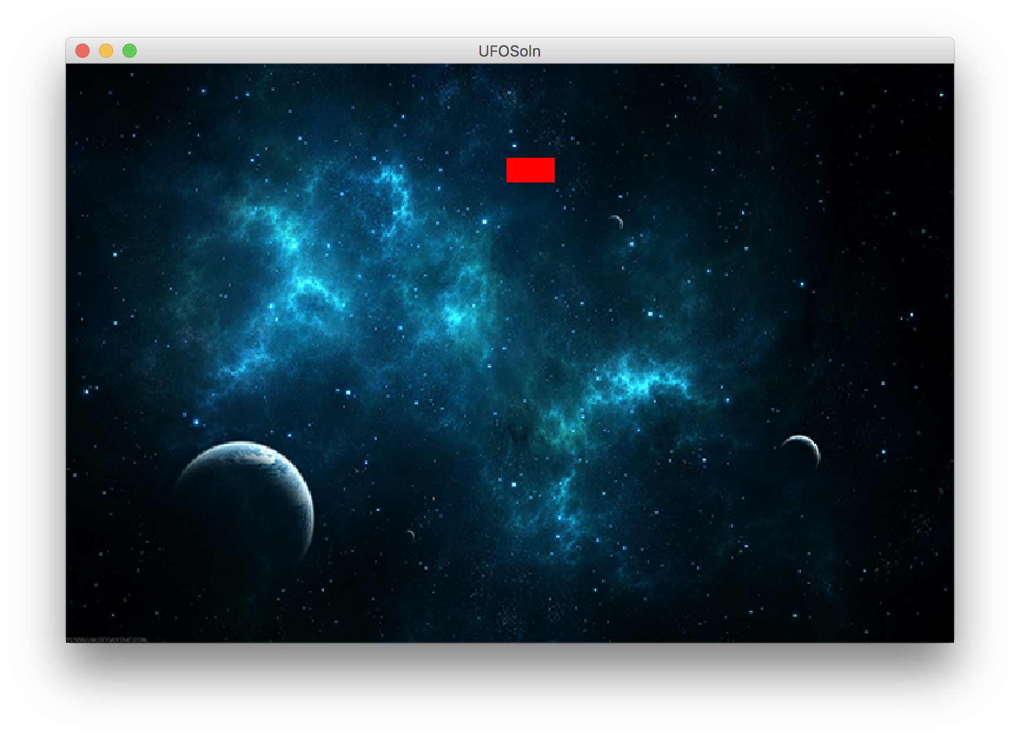
Finish Up

Slide 116
Learning Goals
Be able to trace memory with references

